Slide 1

Python GUIs
OS Specifics
GUI Frameworks
Async Programming

Slide 2

See Also
https://www.tutorialspoint.com/python/python_gui_programming.htm
https://pythonspot.com/en/gui/
http://www.tkdocs.com/tutorial/widgets.html
Notes:
Some additional information on concurrency

Slide 3


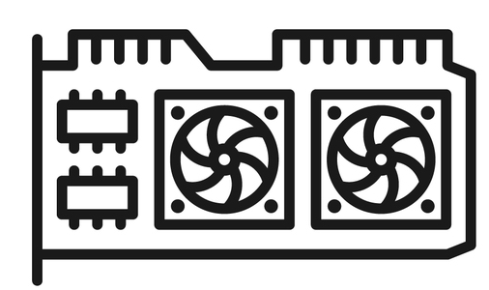
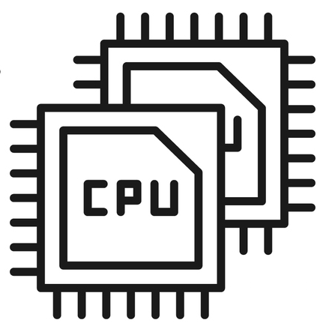


GUIs in Python
The OS (Windows, Mac, Linux) has the graphics hardware/software
Native C support to the OS library
Python wrappers on top of these libraries
Tcl/Tk (Tkinter ships with python)
wxPython (based on wxWidgets)
Qt, OpenGL, and many more
Asynchronous programming – registering callbacks for events
Your “main” sets up the components and events and then ends
The GUI thread calls your handlers
Python C Interface
Native C Code
OS
Hardware
Tkinter
Tcl/Tk
Your Code
wxPython
wxWidgets
Streams of bytes … two ways (into your program and out of your program)
Disks, consoles, sockets, keyboards, printers
Know how to talk streams and you can talk to anything
Initialization (constructor) is different. Use is the same.
Notes:
You may not go this far back, but at one time our computers didn’t have graphical interfaces! You spent all day staring at black and white text displays! But now graphics hardware is built into the motherboard, and graphics drivers are built into the OSes.
Here is your computer hardware … the CPU and the graphics card or built-on chips.
And this is the operating system. It creates windows and buttons and so forth. But the way that code talks to the operating system is very different between Oses. The way you create and manage a button, for instance, is very different on a Windows machine than it is on a Mac.
#1 Developers created cross-platform libraries to hide the details from the code. Now you can write applications that talk to the TCL/TK library and it talks to OS. There is a different library for each OS, but the code on this side of the library is largely portable. You don’t have to learn and code all the specifics for each OS.
#2 And we have Python wrappers on top of these native libraries. This lets your python code access the graphic abilities of the OS.
There are many native graphics libraries you can pick from.
#3 The Tkinter wrapper ships with python. This is a wrapper over the Tcl/Tk library, also included.
#4 WX Python is another library and python wrapper. I’ve used this a lot, but you have to install it yourself.
We are going to use Tkinter in this course because it is already on your computer!
#5 There are many, many more … QT and OpenGL to name a couple more
#6 And here is your python code sitting way up here on top of these wrappers.
#7 Your program starts and creates all the windows and components. Then it registers callback functions on various components. Then … it goes away. It turns control over to the library’s main loop. When the user click on a button … your callback gets called. When the user clicks a checkbox … your callback gets called. When the user resizes the window … your callback gets called.
#8 This is asynchronous programming. Your code is a collection of callbacks that get called in response to events.
Don’t worry, we’ll see this in great detail in the next lesson or two.

Slide 4
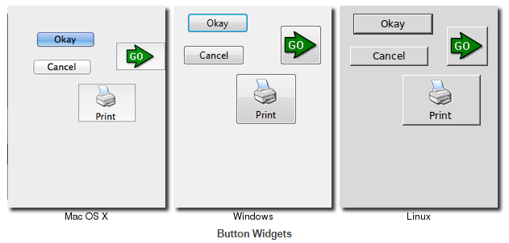
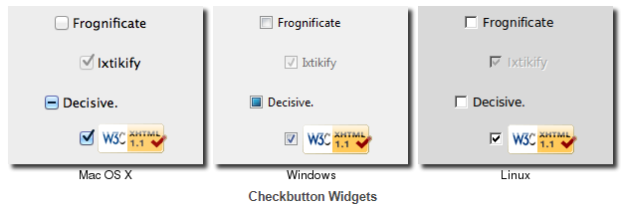
OS-Specific Look and Feel
Notes:
Most GUI elements are universal and work the same way on all the different Oses and browsers.
An active button is all blue on Mac, but only outlined in blue on Windows. Linux outlines the button in black.
Buttons are rounder on Mac than linux. The check overflows the box on the Mac. On the others it is confined within.
Note that some Oses have their own flare. Mac OS puts the menu bar of the active application at the top of the screen. Windows and Linux keeps the menu within the application’s window.
GENERALLY your python GUIs will look and feel similarly on the different Oses. But be sure to test them fully on all supported Oses.

Slide 5
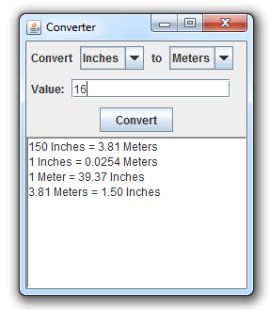
Widgets
Label
ComboBox
Entry
Button
Text
Notes:
GUIs are built from familiar components – also called widgets. They might have slightly different names in different libraries, but you know how they work.
@1 A LABEL is a read only piece of text
@2 A COMBOBOX or choice box gives the user a drop-down list of items to pick from
@3 An ENTRY – also called a text box or a text field – is a line that accepts user input. It generally has a cursor.
@4 You click on BUTTONs to perform an action
@5 A TEXT component – also called a TEXTAREA – is a place to show multiple lines. Here there is no cursor because this text is read-only. The user can copy text out of it but can’t change it.
We’ll look at how to use a whole toolbox of widgets in the next lesson.

Slide 6
Containers and Layout
Frame
Frame
Layout Managers:
Place (absolute)
Pack (horizontal and vertical boxes)
Grid (two dimensional grid)
Notes:
CONTAINERS are widgets that hold and organize other widgets and containers.
@1 For instance, I used a FRAME to group these labels and comboboxes in a single line.
@2 And another to group the label and the text field in a line.
@3 And then those containers are grouped together inside another FRAME.
This is how you build complicated GUIs – a nested tree of components and containers.
@4 A layout manager controls the placement of the components within a container. This is not only for the initial layout of the container … the layout manager controls how components move around when the window is resized.
Different layout managers handle the contents in different ways. We’ll look at these in detail in a future lesson.

Slide 7
Events
def onChangeLeft():
# change "to" choices
def onChangeRight():
# change "from" choices
def onClick():
# read inputs
# calculate answer
# scroll answer
def onKey():
# reject invalid
# ENTER = press convert
Notes:
Once you have your components, containers, and layouts … you need to attach code to the components.
As the user interacts with the GUI … the framework generates EVENTS. You can register functions to be called in response to an event.
@1 For instance, you have this function you want to be called when the convert button is clicked.
@2 You register this function with the button component
@3 You can register a function to be called when the user types a key into the text field. Then you can reject, say, non numeric keys
@4 When the user changes the “FROM” input you could change the available “TO” entries.
@5 Maybe the other way too
We’ll look at events and callbacks in another lesson.

Slide 8
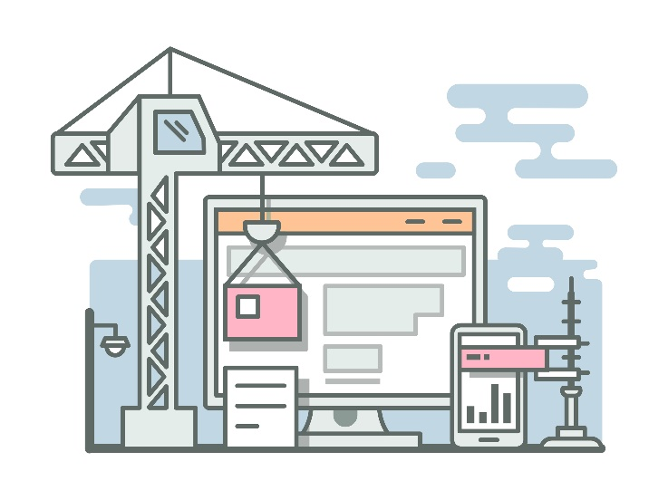
Tinkering
Compare Mac and Windows look and feel. Are there Mac-only or Windows-only widgets?
Compare the look and feel of different browsers. Compare the same browser i.e. Chrome between Mac and Windows. Are there differences?
Notes:
Well, that’s GUI programming at a very high level. We’ll dive into the specifics in the next lessons.
Meanwhile here are some optional things for you to try. Totally optional … nothing for you to send to me.
Compare the Mac and Windows look and feel. Are there widgets that only MAC has … or only Windows has?
Compare the look and feel of different browsers. Now compare the same browser … like Chrome … between different OS es. Are the browser components the same as the OS components? Or do the browsers look more similar in spite of the OS?
Send me email if you have any questions or comments. See you next time!

